Slide 1
Behind the Scenes Revelation 4

Slide 2
Behind the Scenes Revelation 4
Structure of Revelation

Slide 3
Behind the Scenes Revelation 4
Structure of Revelation
Many theories:
Chronological

Slide 4
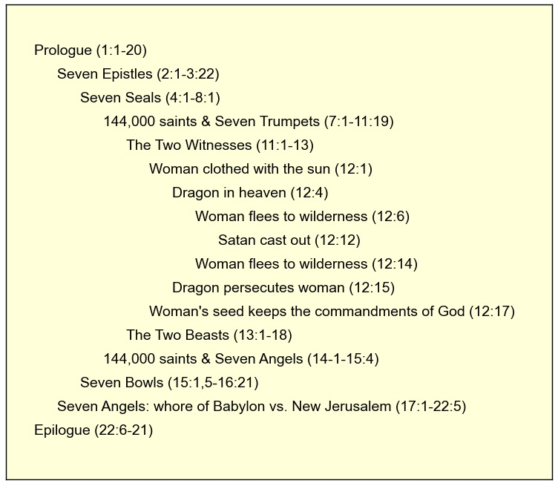
Behind the Scenes Revelation 4
Structure of Revelation
Many theories:
Chronological
Chiasm

Slide 5
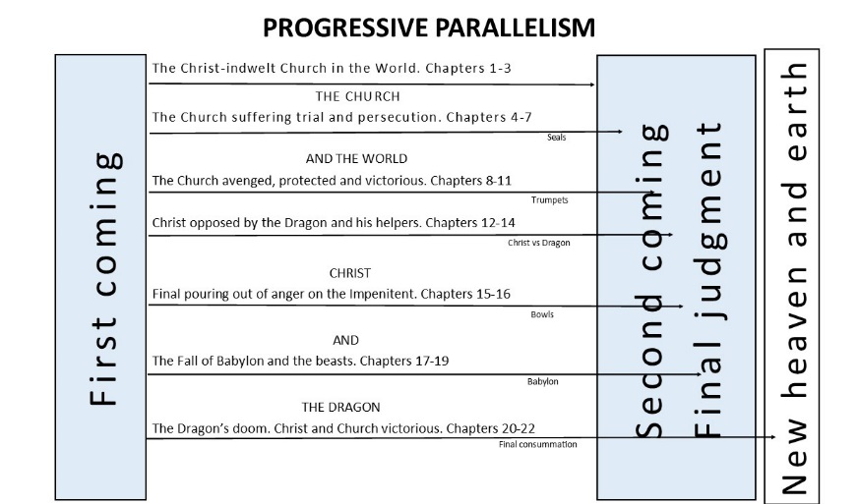
Behind the Scenes Revelation 4
Structure of Revelation
Many theories:
Chronological
Chiasm
Progression

Slide 6
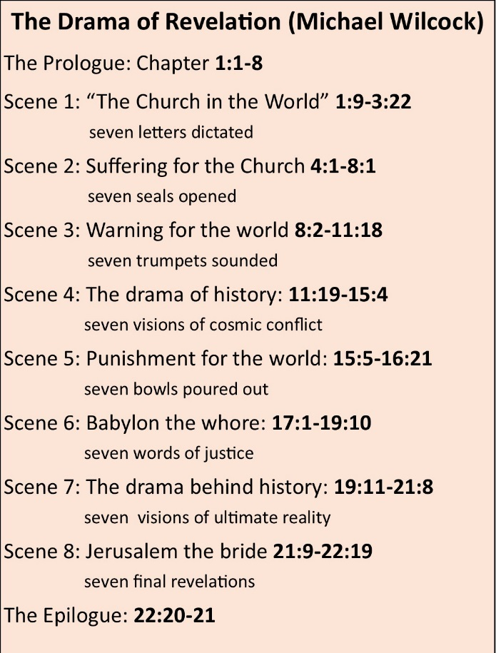
Behind the Scenes Revelation 4
Structure of Revelation
Many theories:
Chronological
Chiasm
Progression
Scenes in Drama

Slide 7
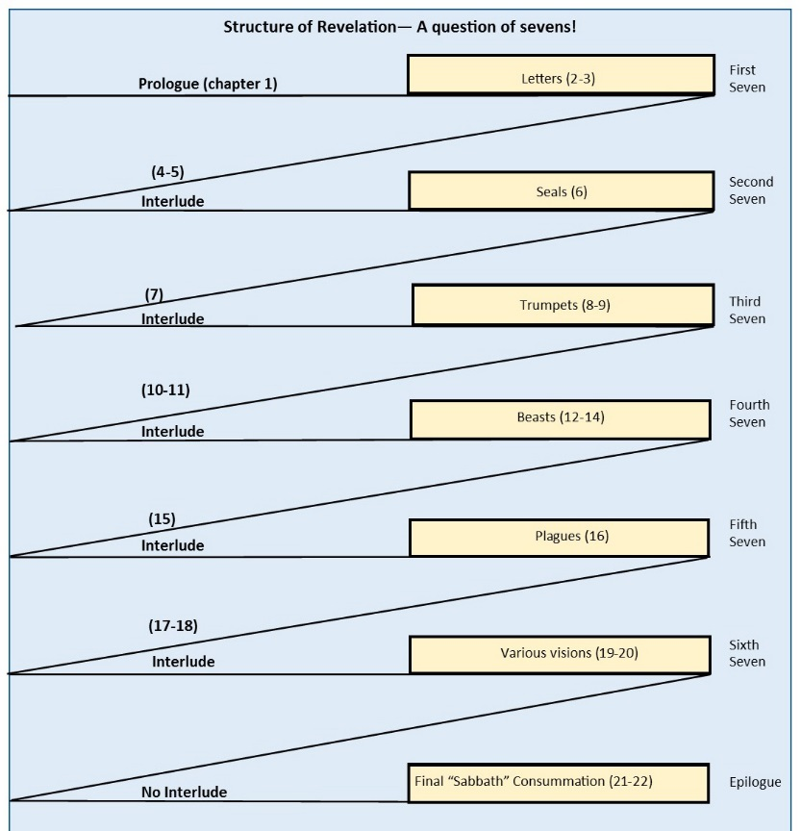
Behind the Scenes Revelation 4
Structure of Revelation
Many theories:
Chronological
Chiasm
Progression
Scenes in Drama
Sevens + interludes

Slide 8
Behind the Scenes Revelation 4
Structure of Revelation
Many theories:
Chronological
Chiasm
Progression
Scenes in Drama
Sevens + Interludes
Overviews

Slide 9
Behind the Scenes Revelation 4
“Had the author intended a precise chronology of the last days, he undoubtedly would have made that plain…At times John moves quickly ahead to the eternal state in order to encourage the redeemed with a vision of the bliss that awaits them. At other times he returns to the past to interpret the source of the hostility being experienced by the church” Robert H Mounce

Slide 10
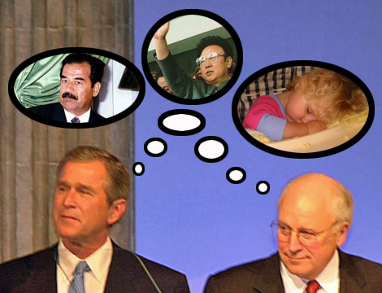
Behind the Scenes Revelation 4
Axis of Evil

Slide 11
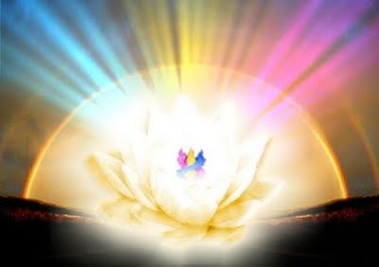
Behind the Scenes Revelation 4
The King is in the Middle

Slide 12
Behind the Scenes Revelation 4
What is now and what must take place later

Slide 13
Behind the Scenes Revelation 4
What is now and what must take place later
What must soon take place (1:1)

Slide 14
Behind the Scenes Revelation 4
What is now and what must take place later
What must soon take place (1:1)
What is now and what will take place later (1:19)

Slide 15
Behind the Scenes Revelation 4
What is now and what must take place later
What must soon take place (1:1)
What is now and what will take place later (1:19)
What must take place after this (4:1)

Slide 16
Behind the Scenes Revelation 4
What is now and what must take place later
What must soon take place (1:1)
What is now and what will take place later (1:19)
What must take place after this (4:1)
What must soon take place (22:6)

Slide 17
Behind the Scenes Revelation 4
What is now and what must take place later
What is = the world as we see it
What must happen = the new world as God wants it

Slide 18
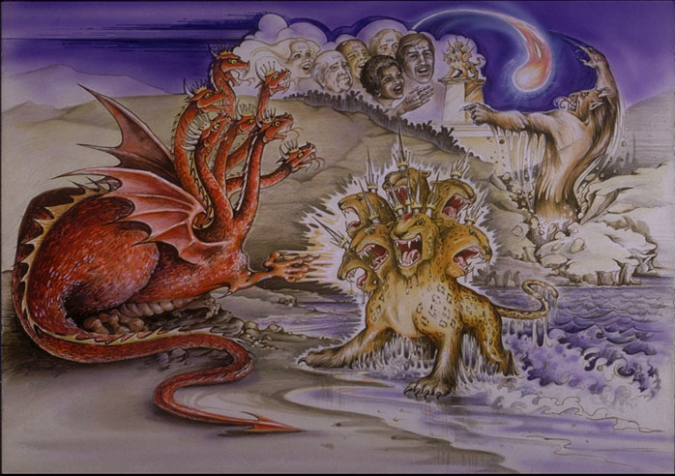
Behind the Scenes Revelation 4
What is now
Now: Satanic trinity- see chapters 12 & 13

Slide 19
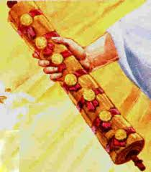
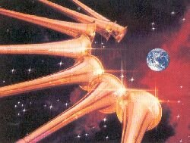
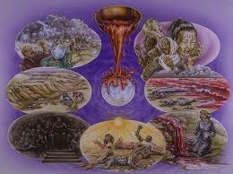
Behind the Scenes Revelation 4
What must take place later
Seven seals – chapters 6-8
Seven trumpets – chapters 8-11
Seven bowls – chapter 16

Slide 20
Behind the Scenes Revelation 4
What must take place later
Two high points in Revelation
7th trumpet: “The kingdom of the world has become the kingdom of our Lord and of his Christ and he will reign for ever and ever” (11:15).
After final judgment: “Now the dwelling of God is with men, and he will live with them. They will be his people, and God himself will be with them and be their God” (21:3).

Slide 21
Behind the Scenes Revelation 4
What must take place later
Why? Why must all these things happen?

Slide 22
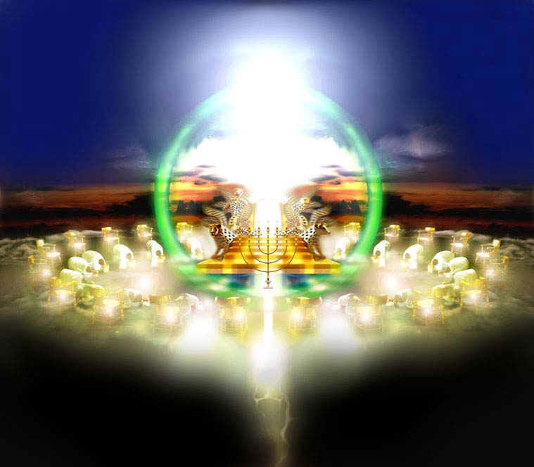
Behind the Scenes Revelation 4
A throne – 4:2-3a

Slide 23
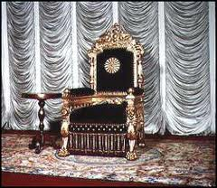
Behind the Scenes Revelation 4
A throne – 4:2-3a
a false throne and an imposter
The beast I saw resembled a leopard, but had feet like those of a bear and a mouth like that of a lion. The dragon gave the beast his power and his throne and great authority (13:2)

Slide 24
Behind the Scenes Revelation 4
A throne – 4:2-3a
The splendour of God’s throne

Slide 25
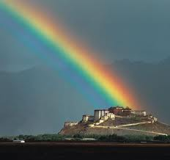
Behind the Scenes Revelation 4
A throne – 4:2-3a
The splendour of God’s throne
Rainbow
“Like the appearance of a rainbow in the clouds on a rainy day, so was the radiance around him. This was the appearance of the likeness of the glory of the Lord.” Ezekiel 1:28

Slide 26
Behind the Scenes Revelation 4
A throne – 4:2-3a
The splendour of God’s throne
Rainbow
Sea of glass
“something like a vault, sparkling like crystal, and awesome”. Ezekiel 1:22
“they saw the God of Israel. Under his feet was something like a pavement made of lapis lazuli, as bright blue as the sky” Exodus 24:10.

Slide 27
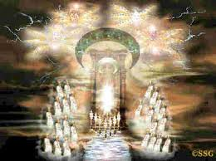
Behind the Scenes Revelation 4
A throne – 4:2-3a
The splendour of God’s throne
Rainbow
Sea of glass
Twenty-four thrones

Slide 28
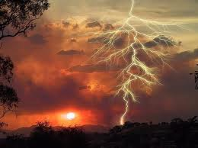
Behind the Scenes Revelation 4
A throne – 4:2-3a
The splendour of God’s throne
Rainbow
Sea of glass
Twenty-four thrones
Special effects

Slide 29
Behind the Scenes Revelation 4
A throne – 4:2-3a
The splendour of God’s throne
Rainbow
Sea of glass
Twenty-four thrones
Special effects
“There was thunder and lightning, with a thick cloud…, and a very loud trumpet blast. Everyone in the camp trembled. Then Moses led the people out of the camp to meet with God, and they stood at the foot of the mountain. Mount Sinai was covered with smoke, because the Lord descended on it in fire. The smoke billowed up from it like smoke from a furnace, and the whole mountain trembled violently. As the sound of the trumpet grew louder and louder, Moses spoke and the voice of God answered him” Exodus 19:16-19

Slide 30
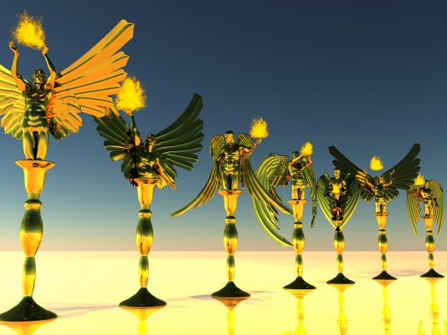
Behind the Scenes Revelation 4
A throne – 4:2-3a
The splendour of God’s throne
Rainbow
Sea of glass
Twenty-four thrones
Special effects
Before the throne

Slide 31
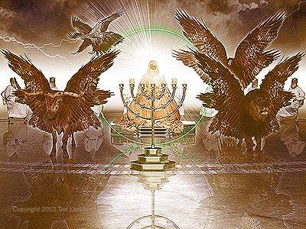
Behind the Scenes Revelation 4
A throne – 4:2-3a
The splendour of God’s throne
Rainbow
Sea of glass
Twenty-four thrones
Special effects
Before the throne
Four living creatures

Slide 32
Behind the Scenes Revelation 4
A throne – 4:2-3a
The splendour of God’s throne
Worship of He who is on the Throne

Slide 33
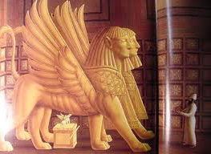
Behind the Scenes Revelation 4
A throne – 4:2-3a
The splendour of God’s throne
Worship of He who is on the Throne
Cherubim
“Day and night they never stop saying: ‘Holy, holy, holy is the Lord God Almighty, ’who was, and is, and is to come” (v8b)
(See also Isaiah 6)

Slide 34
Behind the Scenes Revelation 4
A throne – 4:2-3a
The splendour of God’s throne
Worship of He who is on the Throne
Cherubim
The elders
Whenever the living creatures give glory, honour and thanks …the twenty-four elders fall down before him who sits on the throne and worship him who lives for ever and ever. They lay their crowns before the throne and say: ‘You are worthy, our Lord and God, to receive glory and honour and power for you created all things, and by your will they were created and have their being.’ (v.9-11)

Slide 35
Behind the Scenes Revelation 4
A throne – 4:2-3a
The splendour of God’s throne
Worship of He who is on the Throne
What about our worship?

Slide 36
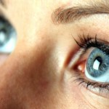
Behind the Scenes Revelation 4
A throne – 4:2-3a
The splendour of God’s throne
Worship of He who is on the Throne
What about our worship?
True worship focuses on the Real Throne

Slide 37
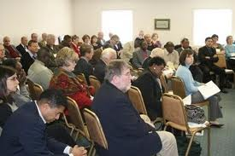
Behind the Scenes Revelation 4
A throne – 4:2-3a
The splendour of God’s throne
Worship of He who is on the Throne
What about our worship?
True worship focuses on the Real Throne
True worship is corporate

Slide 38
Behind the Scenes Revelation 4
A throne – 4:2-3a
The splendour of God’s throne
Worship of He who is on the Throne
What about our worship?
True worship focuses on the Real Throne
True worship is corporate
True worship is a response to God’s love

